Slide 1
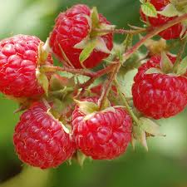
Abiotic stress investigation methods of horticultural plants
cDNA - AFLP TECHNIC Amplified Fragment Length Polymorphisms (Vos et al., 1995)

Slide 2
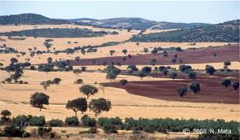
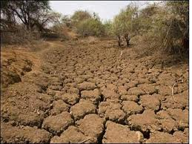
INTRODUCTION
According to the World Atlas of Desertification, UNEP (United Nations Environment Programme), dry lands cover 40% of the world’s land surface (almost 5.1 billion ha), and they are the habitat and source of livelihood for about 1 billion people. With the growth of population and the development of modern agro-industry and the other industries, extension of the dry land surfaces becomes a growing concern all over the world. This concern is reflected in the Convention on Biological Diversity’s dry lands work program, and in the establishment of the UN Convention to Combat Desertification. To mitigate the effects of drought, it is very important first to promote the effective and efficient use of existing plant resources, second to investigate the physiological processes and mechanisms that help plants to acclimatize to the water deficiency conditions. It is assumed that molecules and compounds such as proline, glycine betaine and soluble sugars etc. synthesized and accumulated during desiccation play an important role in the protection of the plants from stress . However, at this time the molecular basis for these protective mechanisms is almost unknown. In this experiment, the screening of the differentially expressed genes in water deficiency growth conditions was accomplished by means of the high reproductive technique (cDNA-AFLP). By this method we identified in stressed plants multiple polymorphic transcript-derived fragments (TDFs) that highlight specific plant reactions on molecular level.
eucalandproject.eu
freereporter.info

Slide 3
MATERIAL AND METHODS
Plant material
Raspberry (Rubus idaeus L.) plants were grown in the greenhouse of the “V. Adavachi” Research Station (University of Agricultural Sciences and Veterinary Medicine of Iasi). Stressed plants were grown on the soil with 35% water hydration, and control plants were normal hydrated. Raspberry leaves were collected from mature greenhouse-grown plants and were immediately frozen in liquid nitrogen and stored at −80 ºC.
RNA extraction
Total RNA was isolated from raspberry very fine grinded leaves, in liquid nitrogen, with the SpectrumPlantTotal RNA Kit according to the manufacturer’s protocol. RNA quality was checked using Bioanalyzer 2100 and RNA 6000 Nano Kit that allow visualization of 18S and 28S subunits and calculation of RNA Integrity Number (RIN)

Slide 4
First-strand cDNA synthesis
The first-strand cDNA synthesis was accomplished with SuperScript II Reverse Transcriptase (RT) Kit that is an engineered version of MMLV RT with reduced RNase H activity and increased thermal stability.
AAAAA
RT
TTTTT
AAAAA
RT
TTTTT
Second-strand cDNA synthesis
The second-strand cDNA synthesis was performed with the SuperScript Double-Stranded cDNA Synthesis Kit that contains all of the reagents, except an oligo(dT) containing primer, necessary to make double-stranded cDNA from total RNA or poly A⁺ selected RNA (mRNA).
AAAAA
RT
TTTTT

Slide 5
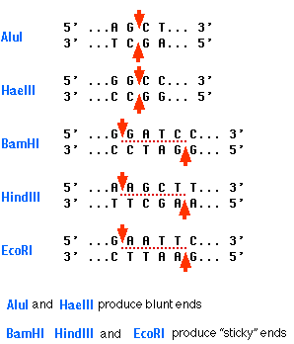
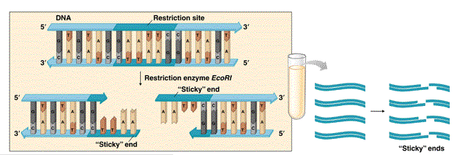
The next steps of cDNA-AFLP analysis were made with AFLP Analysis System I, AFLP Starter Primer Kit according to the manufacturer’s protocols.
Restriction Endonuclease Digestion
To prepare an AFLP template, cDNA is digested with two restriction endonucleases simultaneously. This step generates the required substrate for ligation and subsequent amplification. The restriction fragments for amplification are generated by two restriction endonucleases: EcoR I and Mse I. EcoR I has a 6-bp recognition site, and Mse I has a 4-bp recognition site. When used together, these enzymes generate small DNA fragments that will amplify well and are in the optimal size range (<1 kb) for separation on denaturing polyacrylamide gels. Due to primer design and amplification strategy, these EcoR I – Mse I fragments are preferentially amplified (rather than EcoR I – EcoR I or Mse I – Mse I fragments).

Slide 6
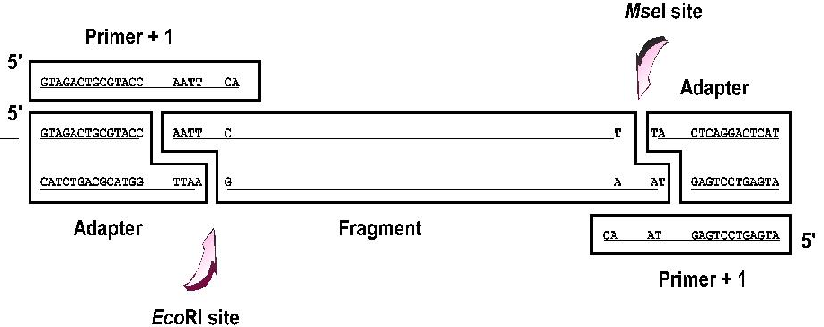
Ligation of Adapters
After heat inactivation of the restriction endonucleases, the cDNA fragments are ligated to EcoR I and Mse I adapters to generate template DNA for amplification. These common adapter sequences flanking variable cDNA sequences serve as primer binding sites on these restriction fragments. Using this strategy, it is possible to amplify many DNA fragments without having prior sequence knowledge.

Slide 7
Amplification Reactions
PCR was performed in two consecutive steps. In the first step, called preamplification, cDNAs are amplified with AFLP primers each having one selective nucleotide. The PCR products of the preamplification reaction was diluted and used as a template for the selective amplification using two AFLP primers (the EcoR I selective primer and Mse I selective primer), each containing three selective nucleotides. This two-step amplification strategy generated enough templates DNA for thousands of AFLP reactions. The selective primers in the AFLP Analysis System I contain three selective nucleotides. In practice, using the AFLP Analysis System I with plants having genomes ranging in size from 5 × 108 to 6 × 109 bp, the number of fragments amplified per sample per primer pair averages 50, but may range from as low as 10 to ~ 100 depending on the sequence context of the selective nucleotides, and the complexity of the genome.
EcoRI PRE-SELECTIVE PRIMER
GTAGACTGCGTACC AATT CA
CA AT GAGTCCTGAGTA
MseI PRE-SELECTIVE PRIMER
PCR preamplification reactions program performed 20 cycles at:
94ºC for 30 s
56ºC for 60 s
72ºC for 60 s

Slide 8
SELECTIVE PRIMER
FAM
EcoRI SELECTIVE PRIMER (labeled)
GTAGACTGCGTACC AATT CACT
GTAGACTGCGTACC AATT CA
CA AT GAGTCCTGAGTA
GACA AT GAGTCCTGAGTA
MseI SELECTIVE PRIMER
PCR selective amplification reactions program performed 33 cycles at:
A. One cycle at 94°C for 30 s; 65°C for 30 s; and 72°C for 60 s;
B. Lowered the annealing temperature each cycle 1°C during 9 cycles. This gives a touchdown phase of 10 cycles;
C. The last 23 cycles at:
94°C for 30 s;
56°C for 30 s;
72°C for 60 s.
Separation of Amplified Fragments on Denaturing Polyacrylamide Gels
Products from the selective amplification was separated on a 4% agarose gel. The resultant banding pattern was manually analyzed for polymorphic transcript-derived fragments (TDFs).

Slide 9
RESULTS

Slide 13
CONCLUSIONS
Screening 64 primer combinations identified multiple transcript-derived fragments (TDFs) that are differentially expressed in water stress conditions. The differences between control and stressed plants were qualitative when TDFs were either present or absent or quantitative when TDFs showed different levels of expression. The results show that cDNA-AFLP is a valuable technique for studying expression patterns of genes involved in sensitivity/tolerance mechanisms to water stress in red raspberry
Acknowledgments
This study has been financed by the National Authority for Scientific Research, Operational Program POSCCE, ID 524, contract no. 151/2010, project title “The significance of the relationship among genomic response, phenylpropanoid metabolism and photosynthesis for the optimization of biosynthetic potential of raspberry and blackberry cultivars in abiotic stress conditions”
THANK YOU
thompson-morgan.com

